Slide 1
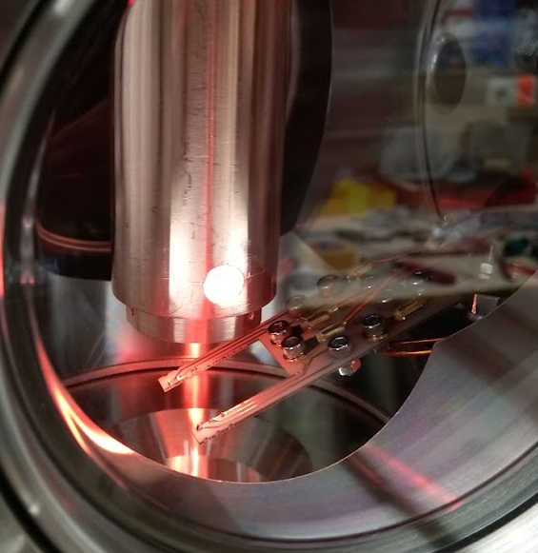
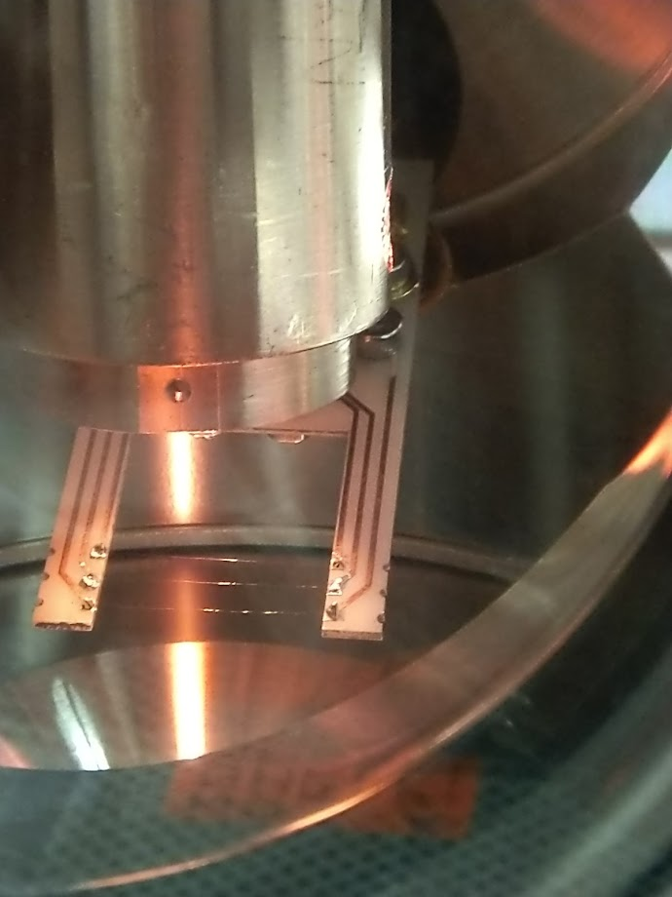
Sketches
HABS
Z-translator
2 cm
Calorimeter Wires
Z-translator

Slide 2
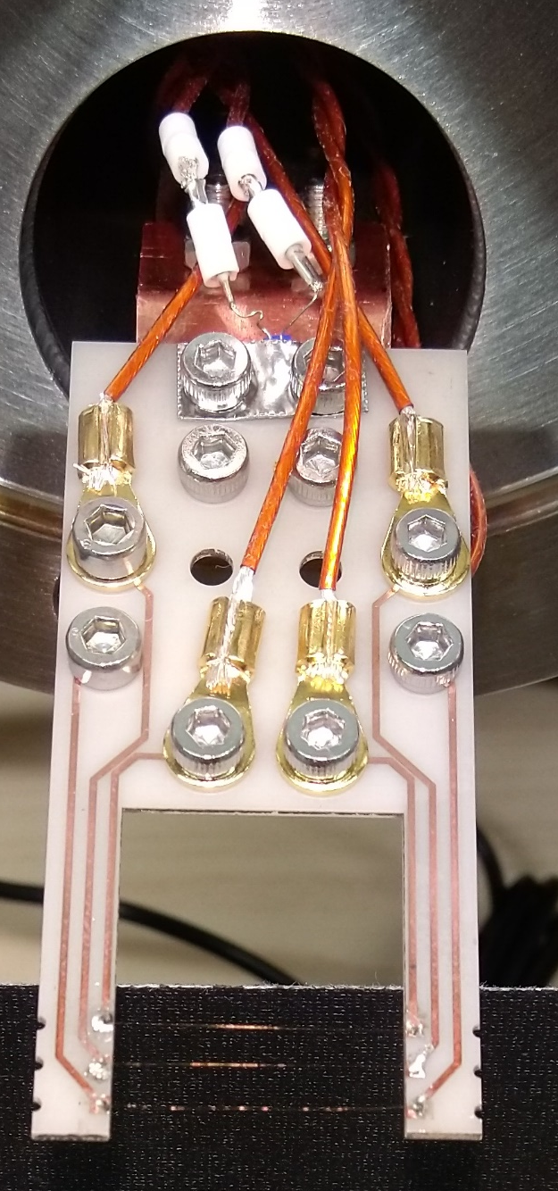
Sketches
HABS
Z-translator
2 cm
Calorimeter Wires

Slide 3
Sketches
HABS
2 cm
Z-translator
Calorimeter Wires

Slide 4
Sketches
HABS
20mm
Z-translator
Calorimeter Wires

Slide 5
Sketches
HABS
PT 1000
2 cm
Z-translator
Calorimeter Wires

Slide 6
Outine below

Slide 7
Wire detector Paper Outline
“Wire Calorimeter for Hydrogen Beam Characterization”
Target Journal JVST (Journal of Vacuum Science & Technology)
Current Draft is still JINST format https://www.overleaf.com/read/pybcsfcfpzcn#249ab1
Skope: Minimum viable Wire detecotor paper
From concept to first demonstration of a beam shape measurement
Time frame: ASAP (PRISMA funding period deadline (yesterday))

Slide 8
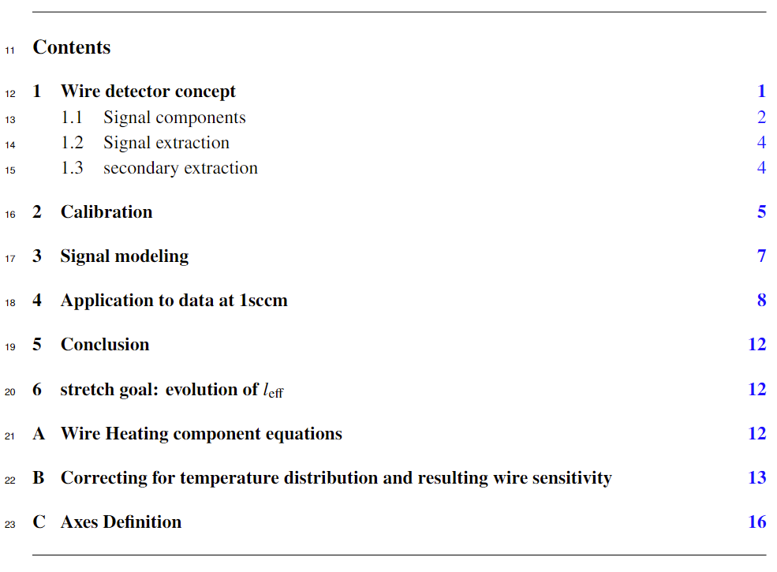
Contents

Slide 9
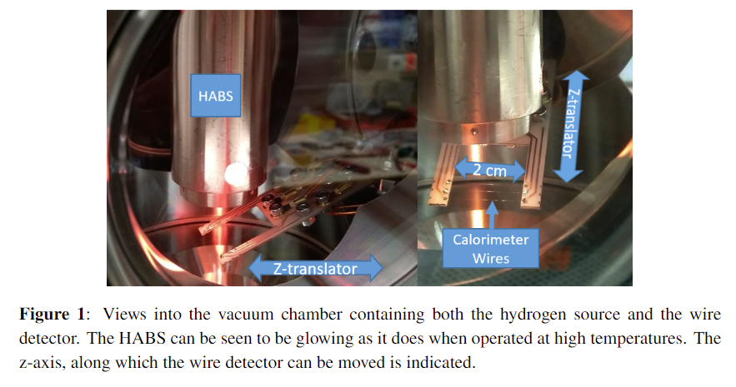
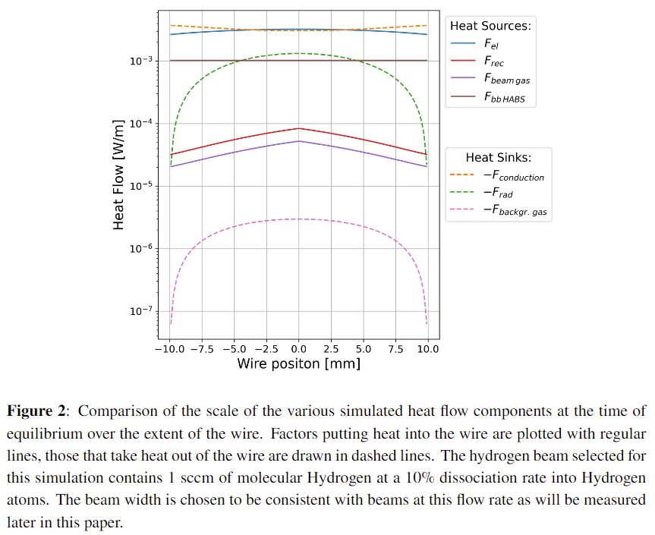
Concept
Introduce Idea of measuring Heating power due to recombination

Slide 10
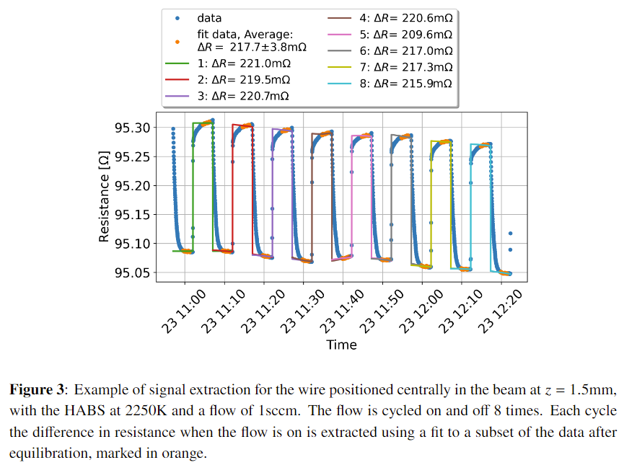
Extraction
Explain what the detector actually measures

Slide 11
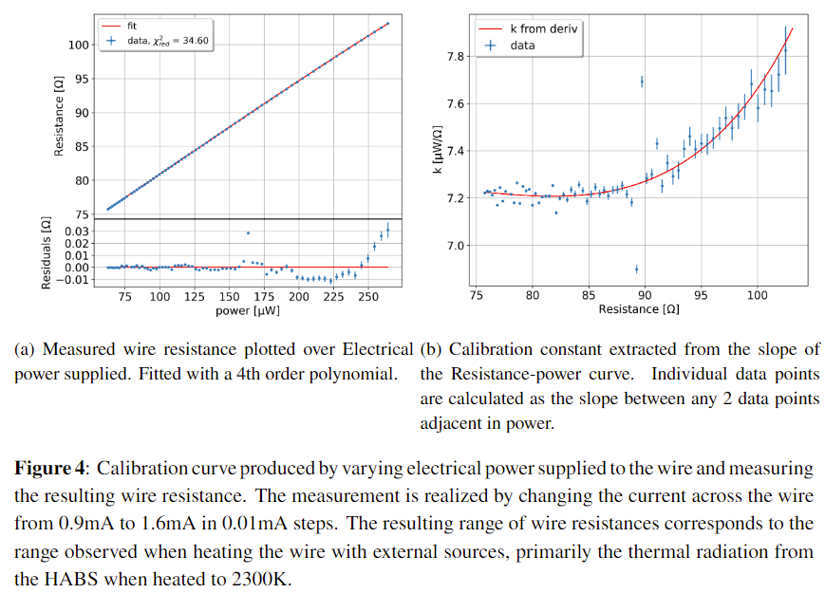
Calibration
Explain how to get from resistance measurements to the Atomic recombination signal

Slide 12
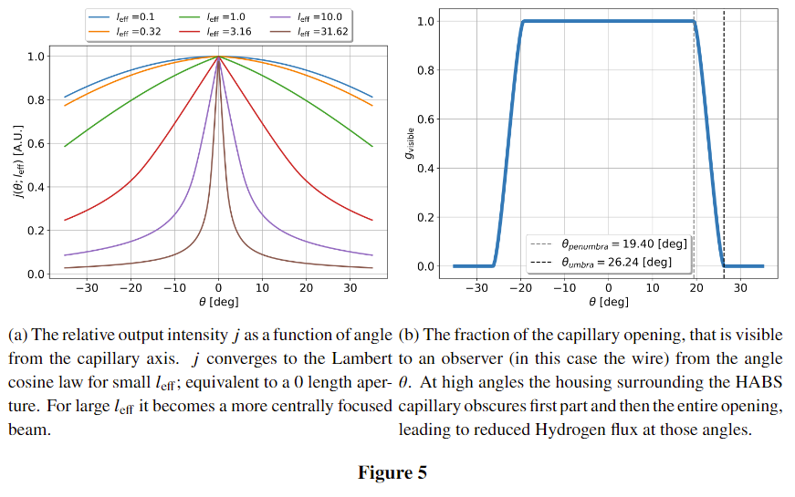
SignalModeling
Introduce the beam shape model

Slide 13
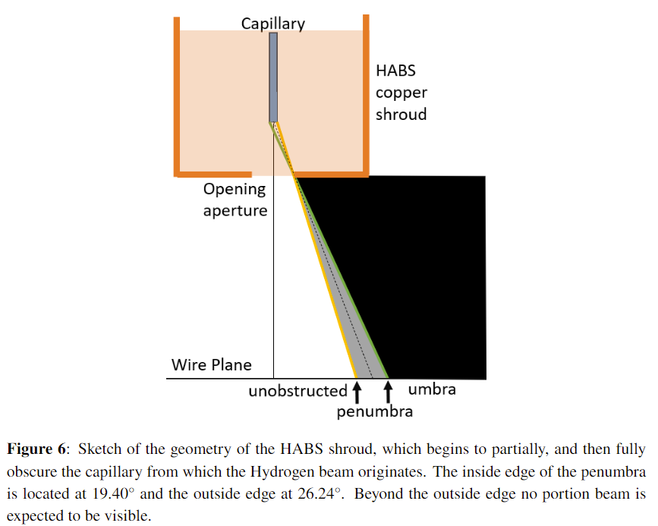
Modeling 2: Geoometric shadowing
Explain geometry of our particular setup and its impact on beam shape reconstruction

Slide 14
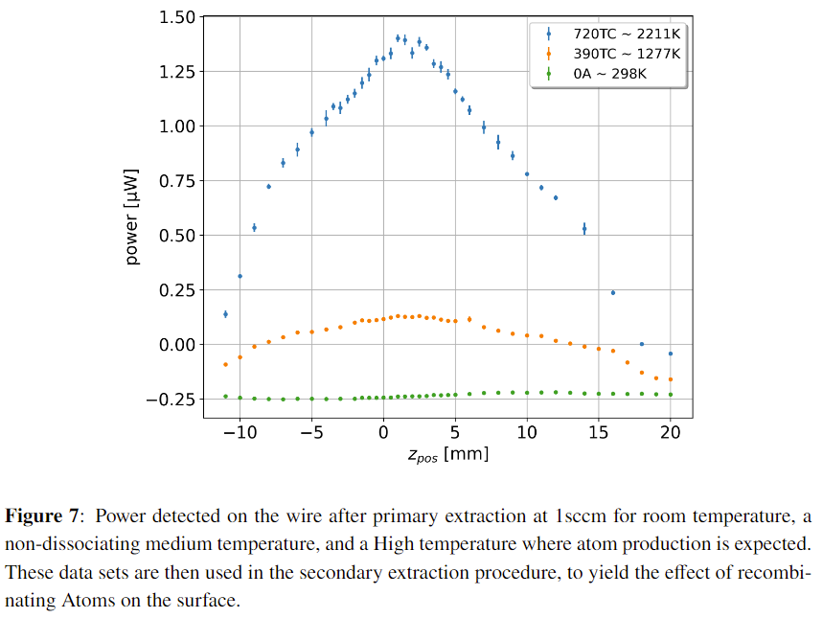
Application to Data: Raw data
Show the synthesis of 3 temperature data sets into the signal we actually care about

Slide 15
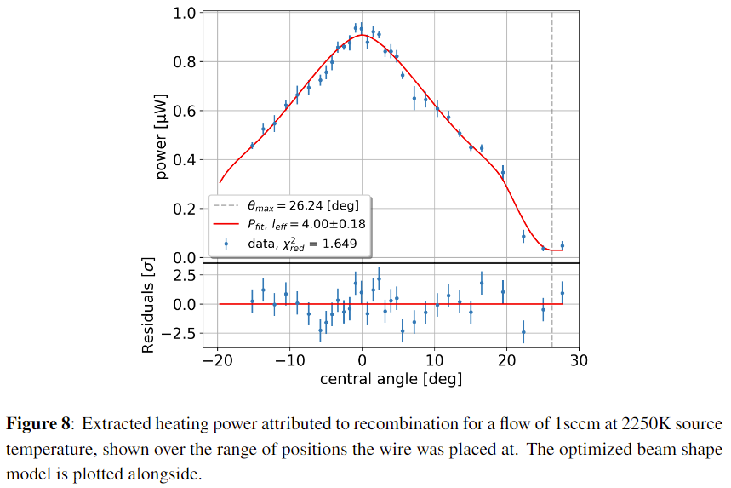
Application to Data: Data Processing and fitting
Final extracted results with fitted model

Slide 16
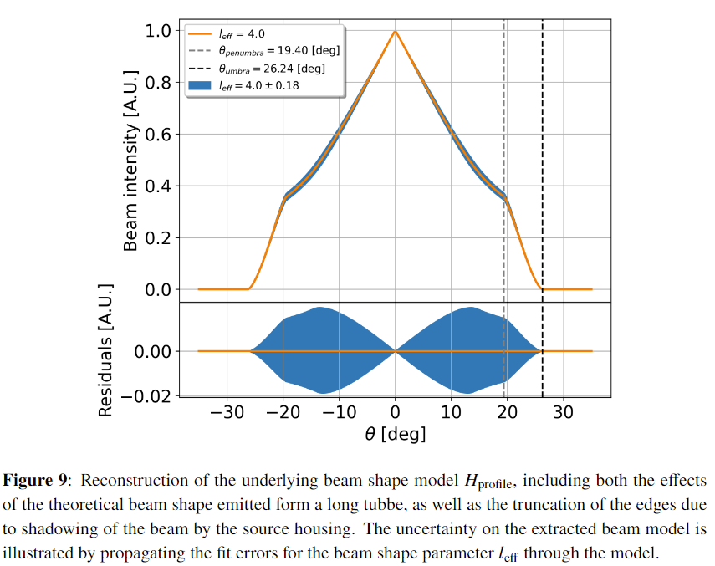
Application to Data: Extracted Beam shape
Reconstruction of the actual underlying beam shape as it comes out of the HABS
Illustrate precision with which we can determine the model dependent beam shape

Slide 17

Extra Slides

Slide 18
BONUS ROUND

Slide 19

Slide Graveyard

